Slide 1


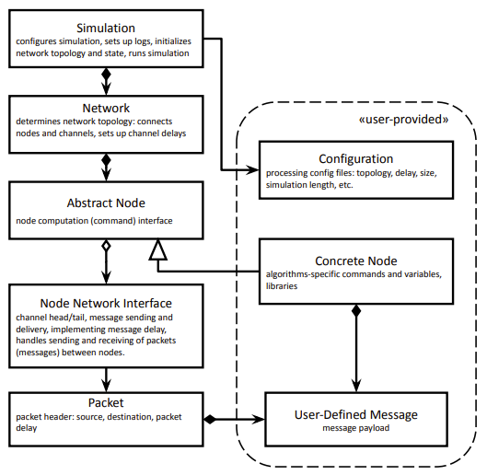
Distributed Systems Synchronizer Algorithms: Leveraging/Extending QUANTAS Library for Improved Use-Case Flexibility
Research Presented by Brandon Renner
Advised by Dr. Mikhail Nesterenko
1
Abbreviated Abstract
2b
Background - Synchronizers
As modern computing needs and practices continue to naturally scale upwards in both size and complexity, the ability to develop new technologies to help facilitate this growth has become a core subject in modern computer science
One such field is distributed computing; the backbone of how many of today’s large-scale, reliable, and fast systems work. A key subfield within distributed computing aimed at creating more reliable and consistent networks is that of Synchronizers
      Project Goal: Improve the ability to implement, test, and analyze synchronizer algorithms in a distributed environment for future, large scale testing
      Strategy: Leverage the KSU-developed QUANTAS library to implement basic proof-of-concept synchronizer infrastructure, laying the groundwork for future development
Synchronizers enable reliable distributed systems by ensuring that nodes in an otherwise asynchronous network structure can reach a consensus, maintain consistent time, and/or lock shared resources to prevent data inconsistency
Core Functions: Facilitate the implementation of synchronous algorithms in distributed, often asynchronous, systems for a theoretical “best of both worlds” approach
4
Topology Development
3
Algorithm Results
To better represent/generate node organization within distributed networks that may exist (or be necessary, as is the case for algorithm β), new topology configurations were developed for use throughout QUANTAS
    These new topologies include basic bi-directional tree/random tree, uni/bi-directional tree-star (universal vertex), and pure random
The specific strategies I used for my QUANTAS implementations are defined in Complexity of Network Synchronization by Baruch Awerbach: Synchronizers Alpha(α) and Beta(β) (see Section 6: References)
    This was chosen in part because of the well-established nature of the literature, and the adequate diversity of methodology presented in the two methods
    Graphs of preliminary data analysis for algorithms α and β:
2a
Background - QUANTAS
5
Future Work
Evaluates distributed algorithms quantitatively, and allows users to measure how well algorithms perform under different conditions
User-friendly, adaptable, and easily extensible; aimed especially at researchers/theorists who want to implement an entirely new idea relatively quickly
Technical Details:
    Simulator core is coded in C++. No further compilers, libraries, or specialized languages are used
    Designed to output simulation data/receive input configurations in JSON format for ease of use
Implementation of real-world computational problems in place of the stand-in computation presented in Awerbach (1985)
Extension of existing node classes for specialized usage in specific synchronizer use cases
Use of new topologies in these and other possible problems within the QUANTAS environment
6
References
Oglio, J., Hood, K., & Nesterenko, M. (2022). QUANTAS Quantitative User-friendly Adaptable Networked Things Abstract Simulator.
Awerbuch, B. (1985). Complexity of Network Synchronization. Journal of the ACM (JACM), 32(4). 804 - 823. https://doi.org/10.1145/4221.4227

